Slide 1







AarogyaQr

Slide 2






PROBLEM STATEMENT
Patients often:
Visit different hospitals or doctors who lack access to their medical history.
Carry physical reports or old prescriptions which are often misplaced or unreadable.
Struggle to communicate past treatments, allergies, or current medications in emergencies.
This leads to delays in treatment, medical errors, and repetitive diagnostic tests.

Slide 3



SOLUTION :-
AarogyaQr is a secure, cloud-based system that enables patients to carry and share their complete medical history instantly via a QR code or phone number.
Core Features:
Upload scanned prescriptions, reports, and images.
Generate a smart QR code (time-bound access) to be scanned by doctors/hospitals.
Auto-categorize documents into: Diagnosis, Prescription, Lab Reports, Discharge Summary, etc.

Slide 4





FLOWCHART :-
User registration
Upload Medical Documents
Auto Categorization
Generate QR Code
Doctor Scans QR
View Medical History

Slide 5

l
PROCESS EXPLANATION :-
The patient signs up using phone/email.
User uploads prescriptions, lab reports, x-rays, discharge summaries, etc.
Files are auto-organized into folders: “Lab Reports”, “Prescriptions”, “X-Rays”, etc.
A dynamic QR code is generated that links to the user's medical history.
Doctor scans the QR using any device — no app or login required.
They are directed to a secure web view showing the patient’s documents.

Slide 6


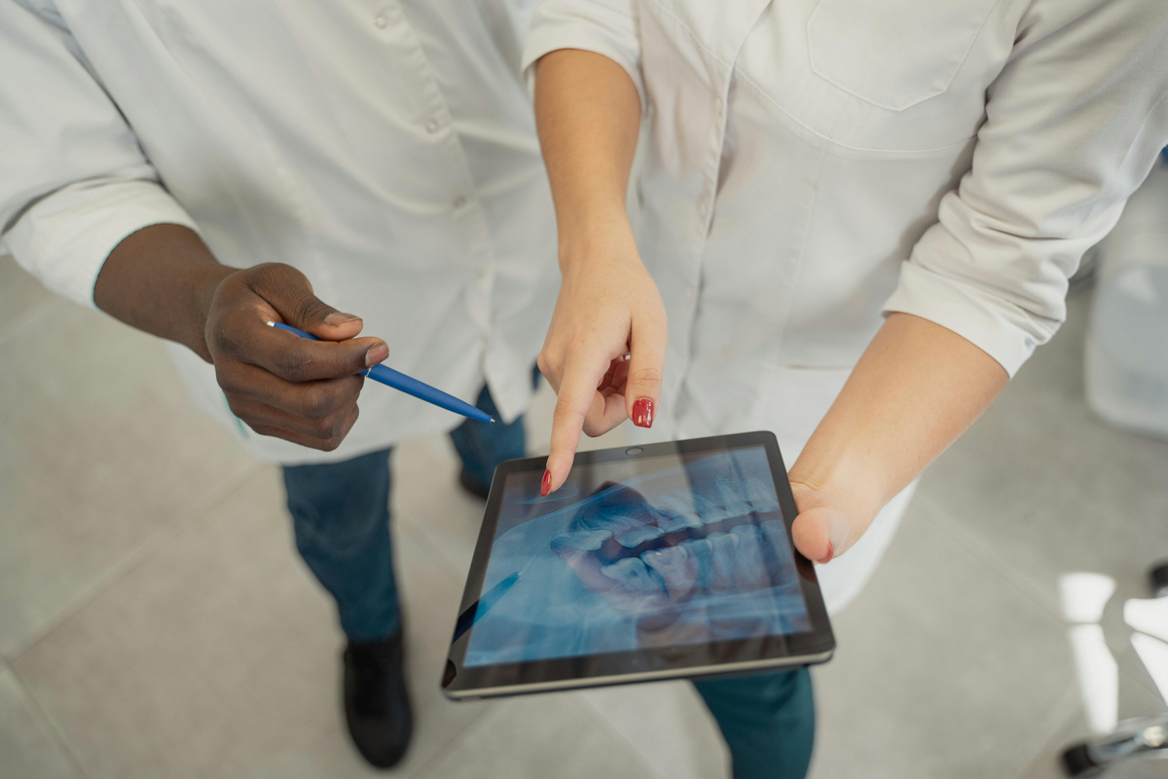
FEATURES & NOVELTY :-
Easy mobile access to health records anytime, anywhere.
Auto-categorization of uploaded reports for quick reference.Time-limited QR sharing for secure doctor access.
No login required for doctors to view history.
Clean, organized display of medical documents by type.
Enables faster, safer treatment in critical situations.

Slide 7


DRAWBACKS AND SHOWSTOPPERS :-
Limited internet access can hinder app usage.
Security risks if QR code gets copied.
Older smartphones may not support the app.
Upload errors can affect medical data accuracy.
Time-limited QR codes might expire unexpectedly.
Doctors must scan QR promptly for access.

Slide 8
TEAM INTELLICORE :-
ADITYA KUMAR
2.HIMANSHU KUMAR
80015 60316
74608 77925
3.RUPAM BETAL
4.RISHITA BARANWAL
6295 890 626
7667346785

Slide 9
THANKYOU
From Intellicore Team

